Slide 1
FIRST SEMESTRE CALENDAR

Slide 3
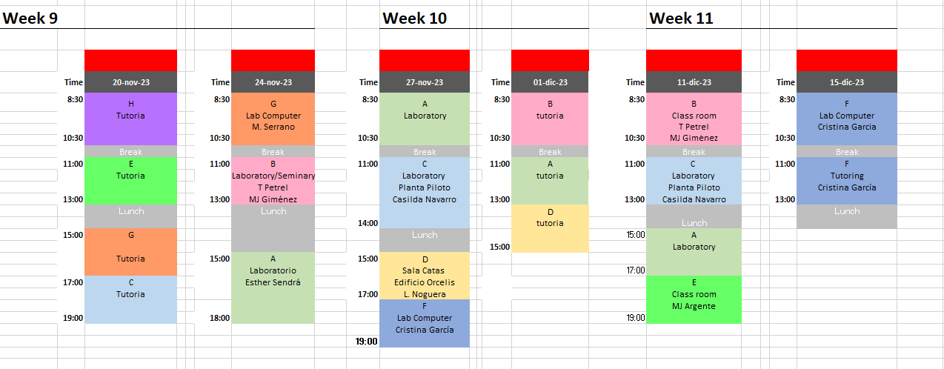

Slide 4
second SEMESTRE CALENDAR

